Slide 1
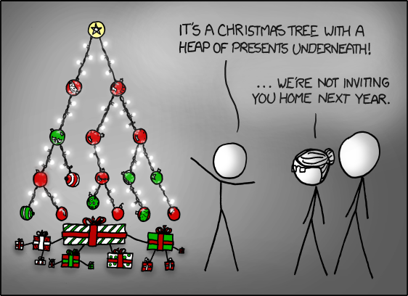
Lecture 14 Applications of priority queues
http://xkcd.com/835/
EECS-214

Slide 2
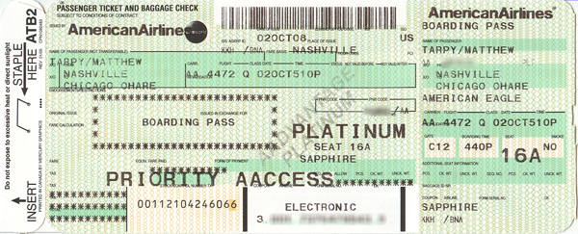
Priority queues
Like normal queues
Objects wait in line to be processed
However, items have an associated numeric priority
Priority specified when added to queue
Objects removed from queue in order of priority
Slightly different API
Insert(object, priority)
Adds object with specified priority
ExtractMax()
Returns highest priority object

Slide 3
Priority queues
Like normal queues
Objects wait in line to be processed
However, items have an associated numeric priority
Priority specified when added to queue
Objects removed from queue in order of priority
Slightly different API
Insert(object, priority)
Adds object with specified priority
ExtractMin()
“Min priority queue”
Returns lowest priority object
Except that in most applications, we usually want the lower “priorities” first

Slide 4
Heaps
9
Heaps are a simple tree structure for implementing priority queues
Rather than requiring their in-order traveral to be sorted
We just require that parent nodes be larger than their child nodes
There are lots of exotic types of heaps
We’ll focus on binary heaps
Which are complete binary trees with the heap property
We’ll get to the completeness thing in a minute…
7
8
1
6
4
5
3
2

Slide 5
Heaps
9
Proposition: the largest element of a heap is always its root
Proof:
Suppose some other element is the largest element
Since it isn’t the root, it must have a parent
Since it’s the largest element, it must be larger than its parent
But that contradicts the definition of a heap
So the largest element must be the root
7
8
1
6
4
5
3
2

Slide 6
Binary heaps
A binary heap is a
Complete binary tree
That satisfies the heap property
Great!
How do we ensure that the heap is a complete binary tree?
9
7
8
1
6

Slide 7
Embedding in an array
It turns out that any complete binary tree can be embedded an array in a particularly cleaver way
We can compute
The position of its parent in the array,
and the positions of its children,
directly from its own position
9
7
8
1
6

Slide 8
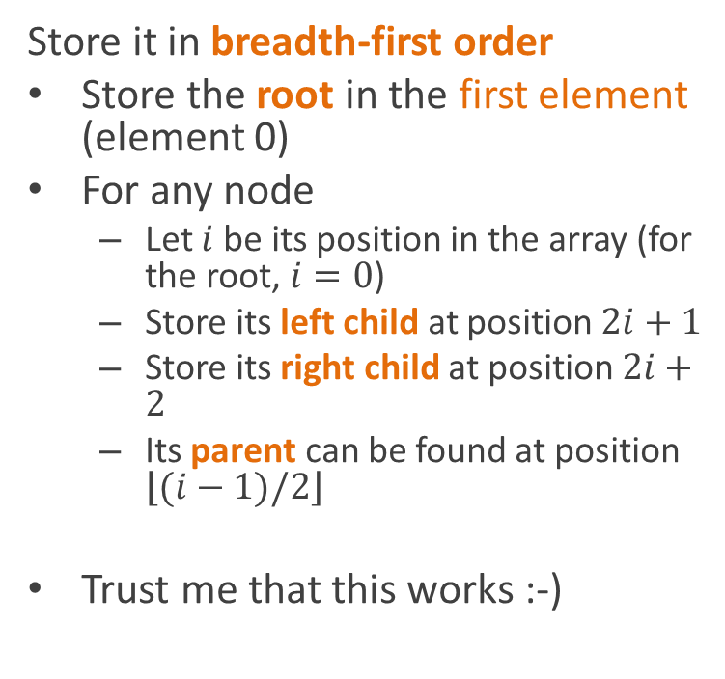
Embedding in an array
Store it in breadth-first order
Store the root in the first element (element 0)
For any node
Let $i$ be its position in the array (for the root, $i=0$)
Store its left child at position $2i+1$
Store its right child at position $2i+2$
Its parent can be found at position $\left\lfloor (i−1)/2\right\rfloor$
Trust me that this works :-)
9
7
8
1
6
9
7
8
1
6

Slide 9
Heap insertion using the array representation
HeapInsert(A, value)
A.size = A.size + 1
i = A.size
while i>0 and A[Parent(i)] < key
A[i] = A[Parent(i)]
i = Parent(i)
A[i] = key
9
7
8
1
6
9
7
8
1
6

Slide 10
Extracting an element
HeapExtractMax(A, value)
max = A[0]
A[0] = A[A.size]
A.size--
Heapify(A,0)
return max
10
7
9
1
6
8
10
7
9
1
6
8

Slide 11
Extracting an element
Heapify(A, i)
l = Left(i)
r = Right(i)
if l≤A.size and A[l]>A[i]
largest = l
else
largest = i
if r≤A.size and A[r]>A[largest]
largest = r
if largest≠i
swap A[i] and A[largest]
Heapify(A, largest)
10
7
9
1
6
8
10
7
9
1
6
8

Slide 12
Sorting
[Pretend I had found some awesome clipart about sorting here]
Priority queues can be used for sort algorithms
Add all items to the queue
Repeatedly extract max
Or min, if it’s a min queue
Write them in order

Slide 13
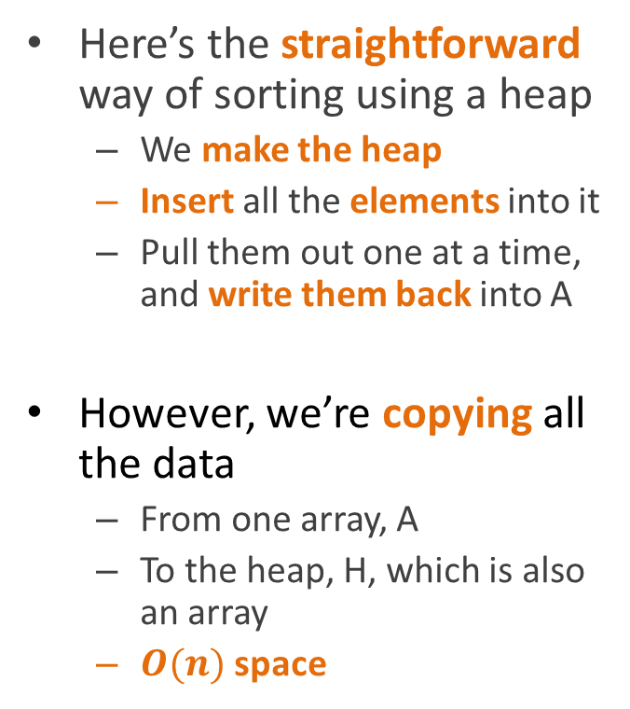
Version 1
Here’s the straightforward way of sorting using a heap
We make the heap
Insert all the elements into it
Pull them out one at a time, and write them back into A
However, we’re copying all the data
From one array, A
To the heap, H, which is also an array
$O(n)$ space
Heapsort(A)
H = new, empty heap
for each e in A
Insert(H, e)
for i = A.Length-1 to 0
A[i] = ExtractMax(H)

Slide 14
In-place heapsort
It would be cooler if we could build the heap inside A itself
How do we do that?
HeapSort(A)
H = new, empty heap
for each e in A
Insert(H, e)
for i = A.Length-1 to 0
A[i] = ExtractMax(H)

Slide 15
Sketch of in-place heap construction

Slide 16
Sketch of in-place heap construction
Start with the array
4
6
2
7
3
1
5

Slide 17
Sketch of in-place heap construction
4
Start with the array
Pretend that it’s a binary tree
It probably doesn’t satisfy the heap property
i.e. there are probably nodes that are larger than their parents
6
2
7
3
1
5
4
6
2
7
3
1
5

Slide 18
Sketch of in-place heap construction
4
But we can think of each leaf as a little 1-element heap
And they automatically satisfy the heap property
Because the only have one element
6
2
7
3
1
5
4
6
2
7
3
1
5

Slide 19
Sketch of in-place heap construction
4
Now run heapify on each of their parents
Heapify
Checks if the parent is larger that both children
6
2
7
3
1
5
4
6
2
7
3
1
5

Slide 20
Sketch of in-place heap construction
4
Now run heapify on each of their parents
Heapify
Checks if the parent is larger that both children
If not, it swaps it with the larger child
6
2
7
3
1
5
4
6
2
7
3
1
5

Slide 21
Sketch of in-place heap construction
4
Now we have
A bunch of 2-level subtrees that
Each satisfy the heap property
7
5
6
3
1
2
4
7
5
6
3
1
2

Slide 22
Sketch of in-place heap construction
4
Repeat at the next level
7
5
6
3
1
2
4
7
5
6
3
1
2

Slide 23
Sketch of in-place heap construction
7
Repeat at the next level
This may require Heapify to recurse
4
5
6
3
1
2
7
4
5
6
3
1
2

Slide 24
Sketch of in-place heap construction
7
Repeat at the next level
This may require Heapify to recurse
But when we’ve done every level
6
5
4
3
1
2
7
6
5
4
3
1
2

Slide 25
Sketch of in-place heap construction
7
Repeat at the next level
This may require Heapify to recurse
But when we’ve done every level
We’ve transformed the data, in-place, into a binary heap
6
5
4
3
1
2
7
6
5
4
3
1
2

Slide 26
Algorithm for in-place heap construction
The last half of the array is guaranteed to be leaves
So we don’t have to do anything with it
BuildHeap(A)
for i = A.Length/2 to 1
Heapify(A, i, A.Length)

Slide 27
Algorithm for in-place heap construction
We want to call Heapify
On every non-leaf node
Starting at the bottom of the tree
And moving upwards
Since lower parts of the tree are at the end of the array,
All we have to do is start halfway through the array
and move back
Calling Heapify
BuildHeap(A)
for i = A.Length/2 to 0
Heapify(A, i, A.Length)

Slide 28
Version 2
Now this is really kind of cool
We build the heap in place
Then we loop
Each iteration removes the maximal element
That shrinks the heap
Making room at the end of the array
Which is where we would want to put the maximal element, anyway!
Heapsort(A)
BuildHeap(A)
for i = A.Length-1 to 1
A[i] = ExtractMax(H)

Slide 29
Completing the sort
7
ExtractMax
Grabs the maximal element, 7
6
5
4
3
1
2
7
6
5
4
3
1
2

Slide 30
Completing the sort
7
ExtractMax
Grabs the maximal element, 7
Replaces it with the last leaf, 2
6
5
4
3
1
2
7
6
5
4
3
1
2

Slide 31
Completing the sort
2
ExtractMax
Grabs the maximal element, 7
Replaces it with the last leaf, 2
And calls Heapify
6
5
4
3
1
2
6
5
4
3
1
2

Slide 32
Completing the sort
2
ExtractMax
Grabs the maximal element, 7
Replaces it with the last leaf, 2
And calls Heapify
6
5
4
3
1
2
6
5
4
3
1
2

Slide 33
Completing the sort
6
ExtractMax
Grabs the maximal element, 7
Replaces it with the last leaf, 2
And calls Heapify
2
5
4
3
1
6
2
5
4
3
1
2

Slide 34
Completing the sort
6
ExtractMax
Grabs the maximal element, 7
Replaces it with the last leaf, 2
And calls Heapify
4
5
2
3
1
6
4
5
2
3
1
2

Slide 35
Completing the sort
6
ExtractMax
Grabs the maximal element, 7
Replaces it with the last leaf, 2
And calls Heapify
Thereby reestablishing the heap property
4
5
2
3
1
6
4
5
2
3
1
2

Slide 36
Completing the sort
6
ExtractMax
Grabs the maximal element, 7
Replaces it with the last leaf, 2
And calls Heapify
Thereby reestablishing the heap property
And now we store 7 (the max) at the end of the array)
4
5
2
3
1
6
4
5
2
3
1
7

Slide 37
Completing the sort
6
Repeat
4
5
2
3
1
6
4
5
2
3
1
7

Slide 38
Completing the sort
6
Grab the max, 6
4
5
2
3
1
6
4
5
2
3
1
7

Slide 39
Completing the sort
6
Grab the max, 6
Replace it with the last leaf, 1
4
5
2
3
1
6
4
5
2
3
1
7

Slide 40
Completing the sort
1
Grab the max, 6
Replace it with the last leaf, 1
4
5
2
3
1
4
5
2
3
1
7

Slide 41
Completing the sort
1
Grab the max, 6
Replace it with the last leaf, 1
Heapify
4
5
2
3
1
4
5
2
3
1
7

Slide 42
Completing the sort
1
Grab the max, 6
Replace it with the last leaf, 1
Heapify
4
5
2
3
1
4
5
2
3
1
7

Slide 43
Completing the sort
5
Grab the max, 6
Replace it with the last leaf, 1
Heapify
4
1
2
3
5
4
1
2
3
1
7

Slide 44
Completing the sort
5
Grab the max, 6
Replace it with the last leaf, 1
Heapify
Store the max, 6, in the next-to-last slot
4
1
2
3
5
4
1
2
3
6
7

Slide 45
Completing the sort
5
Repeat
4
1
2
3
5
4
1
2
3
6
7

Slide 46
Completing the sort
5
Grab the max, 5
4
1
2
3
5
4
1
2
3
6
7

Slide 47
Completing the sort
5
Grab the max, 5
Replace with the last leaf, 3
4
1
2
3
5
4
1
2
3
6
7

Slide 48
Completing the sort
3
Grab the max, 5
Replace with the last leaf, 3
4
1
2
3
4
1
2
3
6
7

Slide 49
Completing the sort
3
Grab the max, 5
Replace with the last leaf, 3
Heapify
4
1
2
3
4
1
2
3
6
7

Slide 50
Completing the sort
3
Grab the max, 5
Replace with the last leaf, 3
Heapify
4
1
2
3
4
1
2
3
6
7

Slide 51
Completing the sort
4
Grab the max, 5
Replace with the last leaf, 3
Heapify
3
1
2
4
3
1
2
3
6
7

Slide 52
Completing the sort
4
Grab the max, 5
Replace with the last leaf, 3
Heapify
Store the max
3
1
2
4
3
1
2
5
6
7

Slide 53
Completing the sort
4
Repeat
3
1
2
4
3
1
2
5
6
7

Slide 54
Completing the sort
4
Grab the max, 4
3
1
2
4
3
1
2
5
6
7

Slide 55
Completing the sort
4
Grab the max, 4
Replace with the last leaf, 2
3
1
2
4
3
1
2
5
6
7

Slide 56
Completing the sort
2
Grab the max, 4
Replace with the last leaf, 2
3
1
2
3
1
2
5
6
7

Slide 57
Completing the sort
2
Grab the max, 4
Replace with the last leaf, 2
Heapify
3
1
2
3
1
2
5
6
7

Slide 58
Completing the sort
2
Grab the max, 4
Replace with the last leaf, 2
Heapify
3
1
2
3
1
2
5
6
7

Slide 59
Completing the sort
3
Grab the max, 4
Replace with the last leaf, 2
Heapify
2
1
3
2
1
2
5
6
7

Slide 60
Completing the sort
3
Grab the max, 4
Replace with the last leaf, 2
Heapify
Store the max
2
1
3
2
1
4
5
6
7

Slide 61
Completing the sort
3
Repeat
2
1
3
2
1
4
5
6
7

Slide 62
Completing the sort
3
Grab the max, 3
2
1
3
2
1
4
5
6
7

Slide 63
Completing the sort
3
Grab the max, 3
Replace with the last leaf, 1
2
1
3
2
1
4
5
6
7

Slide 64
Completing the sort
1
Grab the max, 3
Replace with the last leaf, 1
2
1
2
1
4
5
6
7

Slide 65
Completing the sort
1
Grab the max, 3
Replace with the last leaf, 1
Heapify
2
1
2
1
4
5
6
7

Slide 66
Completing the sort
2
Grab the max, 3
Replace with the last leaf, 1
Heapify
1
2
1
1
4
5
6
7

Slide 67
Completing the sort
2
Grab the max, 3
Replace with the last leaf, 1
Heapify
Store the max
1
2
1
3
4
5
6
7

Slide 68
Completing the sort
2
Repeat
1
2
1
3
4
5
6
7

Slide 69
Completing the sort
2
Grab the max, 2
1
2
1
3
4
5
6
7

Slide 70
Completing the sort
2
Grab the max, 2
Replace with the last leaf, 1
1
2
1
3
4
5
6
7

Slide 71
Completing the sort
1
Grab the max, 2
Replace with the last leaf, 1
1
1
3
4
5
6
7

Slide 72
Completing the sort
1
Grab the max, 2
Replace with the last leaf, 1
Heapify
1
1
3
4
5
6
7

Slide 73
Completing the sort
1
Grab the max, 2
Replace with the last leaf, 1
Heapify
1
1
3
4
5
6
7

Slide 74
Completing the sort
1
Grab the max, 2
Replace with the last leaf, 1
Heapify
Store the max
1
2
3
4
5
6
7

Slide 75
Completing the sort
1
Only one element left
So it has to be the smallest element
And it has to be in position 0
We’re done!
1
2
3
4
5
6
7

Slide 76
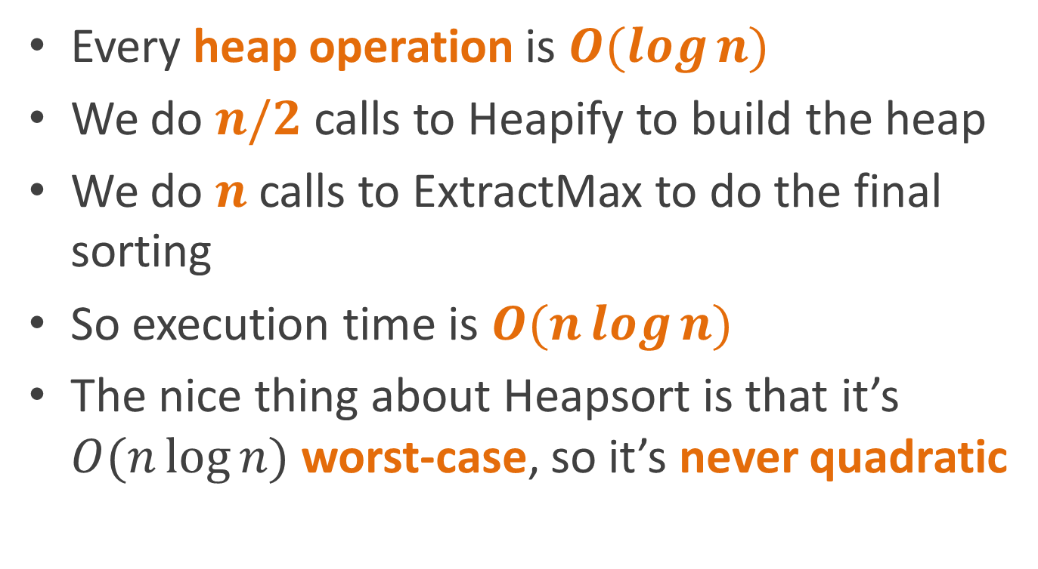
Analysis
Every heap operation is $O(\log{n)}$
We do $n/2$ calls to Heapify to build the heap
We do $n$ calls to ExtractMax to do the final sorting
So execution time is $O(n\log{n})$
The nice thing about Heapsort is that it’s $O(n\log{n)}$ worst-case, so it’s never quadratic

Slide 77
Route planning revisited
Foster
Merchandise Mart
Clark/Lake
State/Lake
Randolf/Wabash
Washington/Wells
Madison/Wabash
Quincy
Adams/Wabash
LaSalle
Library

Slide 78
Route planning revisited
Foster
We used breadth-first search before to find a shortest path in a graph
But BFS treats each edge as being equal
In route planning, different edges take different amounts of time
Merchandise Mart
Clark/Lake
State/Lake
Washington/Wells
Randolf/Wabash
Madison/Wabash
Quincy
Adams/Wabash
LaSalle
Library

Slide 79
Route planning revisited
We can represent this by weighting edges with their “costs”
We’ll assume costs > 0
Costs can represent
Time
Distance
Or any other quantity you’d like to minimize
Foster
20
2
Merchandise Mart
Clark/Lake
1
State/Lake
1
Randolf/Wabash
Washington/Wells
1
1
1
Madison/Wabash
Quincy
1
Adams/Wabash
2
LaSalle
Library
1
3

Slide 80
Path finding with edge costs
How do we make a version of BFS that searches nodes
In order of increasing total path cost
Rather than increasing number of edges
Use a priority queue!
Priority of a node = cost of path from start to that node

Slide 81
Dijkstra’s least-cost path algorithm
Dijkstra(G, s, e)
PQ = new priority queue
Set all node costs to infinity
s.cost = 0
for each node n in G
PQ.Insert(n, n.cost)
while PQ not empty
u = PQ.ExtractMin()
if u == end then done!
for each neighbor v of u
w = weight of edge from u to v
newCost = u.cost+w
if newCost<v.cost
PQ.DecreaseKey(v, newCost)
v.cost = newCost
v.predecessor = u

Slide 82
Wait a minute… decrease key?
We have to add a new operation to our priority queue: decreasing the priority of an item already in the queue
Note that since we’re using extract min, rather than extract max, decreasing the “priority” actually moves it ahead in the queue
How could we implement decrease key?

Slide 83
Implementing DecreaseKey
One way we could do it would be to:
Remove it (somehow)
Reinsert it
But the insert algorithm
Adds it at the bottom of the heap
Swaps it upward until its priority is lower than its parent
At least for a min heap
HeapInsert(A, key)
A.size = A.size + 1
i = A.size
while i>0 and A[Parent(i)] > key
A[i] = A[Parent(i)]
i = Parent(i)
A[i] = key

Slide 84
Implementing DecreaseKey
So DecreaseKey is actually easy:
Just move the node up
Until its in the right place
Just copy the code for insert
And remove the part that starts by inserting it at the end
DecreaseKey(A, i, key)
while i>0 and A[Parent(i)] > key
A[i] = A[Parent(i)]
i = Parent(i)
A[i] = key

Slide 85
Implementing DecreaseKey
Unfortunately, you need to know where the node is stored in the heap
i.e. its index in the stupid heap array
Best done by storing the index in the graph node itself
Have to remember to update it any time the node moves in the heap
DecreaseKey(A, i, key)
while i>0 and A[Parent(i)] > key
A[i] = A[Parent(i)]
i = Parent(i)
A[i] = key

Slide 86
Proving correctness
Notice we have two kinds of nodes
Nodes still in the queue
Nodes that have been removed (that we’re done with)
Dijkstra(G, s, e)
PQ = new priority queue
Set all node costs to infinity
s.cost = 0
for each node n in G
PQ.Insert(n, n.cost)
while PQ not empty
u = PQ.ExtractMin()
if u == end then done!
for each neighbor v of u
w = weight of edge from u to v
newCost = u.cost+w
if newCost<v.cost
PQ.DecreaseKey(v, newCost)
v.cost = newCost
v.predecessor = u

Slide 87
Invariants
For all nodes v
If v is not in the queue,
dist[v] is the length of the shortest path from the start node to v
If v is in the queue,
dist[v] is the length of the shortest path from the start to v just using nodes not in the queue
Dijkstra(G, s, e)
PQ = new priority queue
Set all node costs to infinity
s.cost = 0
for each node n in G
PQ.Insert(n, n.cost)
while PQ not empty
u = PQ.ExtractMin()
if u == end then done!
for each neighbor v of u
w = weight of edge from u to v
newCost = u.cost+w
if newCost<v.cost
PQ.DecreaseKey(v, newCost)
v.cost = newCost
v.predecessor = u

Slide 88
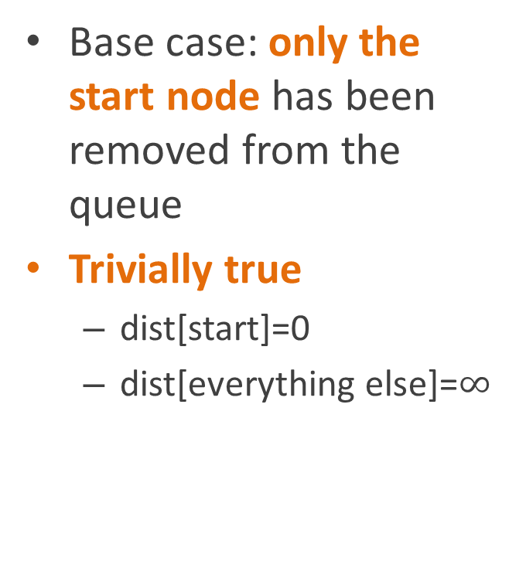
Proof
For all nodes v
If v is not in the queue,
dist[v] is the length of the shortest path from the start node to v
If v is in the queue,
dist[v] is the length of the shortest path from the start to v just using nodes not in the queue
Base case: only the start node has been removed from the queue
Trivially true
dist[start]=0
dist[everything else]=$∞$

Slide 89
Proof
For all nodes v
If v is not in the queue,
dist[v] is the length of the shortest path from the start node to v
If v is in the queue,
dist[v] is the length of the shortest path from the start to v just using nodes not in the queue
Inductive case:
Assume it’s true for the currently visited nodes
Let v be the next node in the queue

Slide 90
Proof
For all nodes v
If v is not in the queue,
dist[v] is the length of the shortest path from the start node to v
If v is in the queue,
dist[v] is the length of the shortest path from the start to v just using nodes not in the queue
Inductive case:
Let v be the next node in the queue
Then
v has the minimum dist[] among the nodes in the queue
dist[v] is the length of the shortest path to v using nodes not in the queue

Slide 91
Proof
Inductive case:
Let v be the next node in the queue
Then
v has the minimum dist[] among the nodes in the queue
dist[v] is the length of the shortest path to v using nodes not in the queue
Claim:
dist[v] is the length of the shortest path using any nodes
Proof:
Assume there’s a shorter path
Case 1: the shorter path contains a node in the queue
Then that node must be closer to start than v
Contradicts (1)

Slide 92
Proof
Inductive case:
Let v be the next node in the queue
Then
v has the minimum dist[] among the nodes in the queue
dist[v] is the length of the shortest path to v using nodes not in the queue
Claim:
dist[v] is the length of the shortest path using any nodes
Proof:
Assume there’s a shorter path
Case 2: the shorter path contains no nodes from the queue
Contradicts (2)

Slide 93
Proof
Inductive case:
Let v be the next node in the queue
Then
v has the minimum dist[] among the nodes in the queue
dist[v] is the length of the shortest path to v using nodes not in the queue
Therefore:
The inductive case holds
The invariants hold
Including when the queue is empty
At which point dist[] has the distances to all the nodes
The algorithm is correct

Slide 94
Running Dijkstra’s algorithm
Foster
20
2
Merchandise Mart
Clark/Lake
1
State/Lake
1
Randolf/Wabash
Washington/Wells
1
1
1
Madison/Wabash
Quincy
1
Adams/Wabash
2
LaSalle
Library
1
3

Slide 95
Initialize node costs
Foster
0
20
2
Merchandise Mart
Clark/Lake
1
State/Lake
1
∞
Randolf/Wabash
Washington/Wells
∞
∞
1
∞
∞
1
1
Madison/Wabash
Quincy
∞
1
∞
Adams/Wabash
2
LaSalle
Library
∞
1
3
∞
∞

Slide 96
Initialize priority queue
Queue:
Foster (0)
Adams (∞)
Clark (∞)
LaSalle (∞)
Library (∞)
Madison (∞)
Mmart (∞)
Quincy (∞)
Randolf (∞)
State (∞)
Washington (∞)
Foster
0
20
2
Merchandise Mart
Clark/Lake
1
State/Lake
1
∞
Randolf/Wabash
Washington/Wells
∞
∞
1
∞
∞
1
1
Madison/Wabash
Quincy
∞
1
∞
Adams/Wabash
2
LaSalle
Library
∞
1
3
∞
∞

Slide 97
Extract min (Foster)
Queue:
Adams (∞)
Clark (∞)
LaSalle (∞)
Library (∞)
Madison (∞)
Mmart (∞)
Quincy (∞)
Randolf (∞)
State (∞)
Washington (∞)
Foster
0
20
2
Merchandise Mart
Clark/Lake
1
State/Lake
1
∞
Randolf/Wabash
Washington/Wells
∞
∞
1
∞
∞
1
1
Madison/Wabash
Quincy
∞
1
∞
Adams/Wabash
2
LaSalle
Library
∞
1
3
∞
∞

Slide 98
Update neighbors
Queue:
State (20)
Adams (∞)
Clark (∞)
LaSalle (∞)
Library (∞)
Madison (∞)
Mmart (∞)
Quincy (∞)
Randolf (∞)
Washington (∞)
Foster
0
20
2
Merchandise Mart
Clark/Lake
1
State/Lake
1
∞
Randolf/Wabash
Washington/Wells
∞
20
1
∞
∞
1
1
Madison/Wabash
Quincy
∞
1
∞
Adams/Wabash
2
LaSalle
Library
∞
1
3
∞
∞

Slide 99
Extract min (State)
Queue:
Adams (∞)
Clark (∞)
LaSalle (∞)
Library (∞)
Madison (∞)
Mmart (∞)
Quincy (∞)
Randolf (∞)
Washington (∞)
Foster
0
20
2
Merchandise Mart
Clark/Lake
1
State/Lake
1
∞
Randolf/Wabash
Washington/Wells
∞
20
1
∞
∞
1
1
Madison/Wabash
Quincy
∞
1
∞
Adams/Wabash
2
LaSalle
Library
∞
1
3
∞
∞

Slide 100
Update neighbors
Queue:
Clark (21)
Randolf (21)
Adams (∞)
LaSalle (∞)
Library (∞)
Madison (∞)
Mmart (∞)
Quincy (∞)
Washington (∞)
Foster
0
20
2
Merchandise Mart
Clark/Lake
1
State/Lake
1
∞
Randolf/Wabash
Washington/Wells
21
20
1
21
∞
1
1
Madison/Wabash
Quincy
∞
1
∞
Adams/Wabash
2
LaSalle
Library
∞
1
3
∞
∞

Slide 101
Extract min (Clark)
Queue:
Randolf (21)
Adams (∞)
LaSalle (∞)
Library (∞)
Madison (∞)
Mmart (∞)
Quincy (∞)
Washington (∞)
Foster
0
20
2
Merchandise Mart
Clark/Lake
1
State/Lake
1
∞
Randolf/Wabash
Washington/Wells
21
20
1
21
∞
1
1
Madison/Wabash
Quincy
∞
1
∞
Adams/Wabash
2
LaSalle
Library
∞
1
3
∞
∞

Slide 102
Update neighbors
Queue:
Randolf (21)
Wash (22)
Mmart (23)
Adams (∞)
LaSalle (∞)
Library (∞)
Madison (∞)
Quincy (∞)
Foster
0
20
2
Merchandise Mart
Clark/Lake
1
State/Lake
1
23
Randolf/Wabash
Washington/Wells
21
20
1
21
22
1
1
Madison/Wabash
Quincy
∞
1
∞
Adams/Wabash
2
LaSalle
Library
∞
1
3
∞
∞

Slide 103
Extract min (Randolf)
Queue:
Mmart (22)
Wash (22)
Adams (∞)
LaSalle (∞)
Library (∞)
Madison (∞)
Quincy (∞)
Foster
0
20
2
Merchandise Mart
Clark/Lake
1
State/Lake
1
22
Randolf/Wabash
Washington/Wells
21
20
1
21
22
1
1
Madison/Wabash
Quincy
∞
1
∞
Adams/Wabash
2
LaSalle
Library
∞
1
3
∞
∞

Slide 104
Update neighbors
Queue:
Wash (22)
Madison (22)
Mmart (23)
Adams (∞)
LaSalle (∞)
Library (∞)
Quincy (∞)
Foster
0
20
2
Merchandise Mart
Clark/Lake
1
State/Lake
1
23
Randolf/Wabash
Washington/Wells
21
20
1
21
22
1
1
Madison/Wabash
Quincy
22
1
∞
Adams/Wabash
2
LaSalle
Library
∞
1
3
∞
∞

Slide 105
Extract min (Washington)
Queue:
Madison (22)
Mmart (23)
Adams (∞)
LaSalle (∞)
Library (∞)
Quincy (∞)
Foster
0
20
2
Merchandise Mart
Clark/Lake
1
State/Lake
1
23
Randolf/Wabash
Washington/Wells
21
20
1
21
22
1
1
Madison/Wabash
Quincy
22
1
∞
Adams/Wabash
2
LaSalle
Library
∞
1
3
∞
∞

Slide 106
Update neighbors
Queue:
Madison (22)
Mmart (23)
Quincy (23)
Adams (∞)
LaSalle (∞)
Library (∞)
Foster
0
20
2
Merchandise Mart
Clark/Lake
1
State/Lake
1
23
Randolf/Wabash
Washington/Wells
21
20
1
21
22
1
1
Madison/Wabash
Quincy
22
1
23
Adams/Wabash
2
LaSalle
Library
∞
1
3
∞
∞

Slide 107
Extract min (Madison)
Queue:
Mmart (23)
Quincy (23)
Adams (∞)
LaSalle (∞)
Library (∞)
Foster
0
20
2
Merchandise Mart
Clark/Lake
1
State/Lake
1
23
Randolf/Wabash
Washington/Wells
21
20
1
21
22
1
1
Madison/Wabash
Quincy
22
1
23
Adams/Wabash
2
LaSalle
Library
∞
1
3
∞
∞

Slide 108
Update neighbors
Queue:
Mmart (23)
Quincy (23)
Adams (23)
LaSalle (∞)
Library (∞)
Foster
0
20
2
Merchandise Mart
Clark/Lake
1
State/Lake
1
23
Randolf/Wabash
Washington/Wells
21
20
1
21
22
1
1
Madison/Wabash
Quincy
22
1
23
Adams/Wabash
2
LaSalle
Library
23
1
3
∞
∞

Slide 109
Extract min (MMart)
Queue:
Quincy (23)
Adams (23)
LaSalle (∞)
Library (∞)
Foster
0
20
2
Merchandise Mart
Clark/Lake
1
State/Lake
1
23
Randolf/Wabash
Washington/Wells
21
20
1
21
22
1
1
Madison/Wabash
Quincy
22
1
23
Adams/Wabash
2
LaSalle
Library
23
1
3
∞
∞

Slide 110
Update neighbors (no changes)
Queue:
Quincy (23)
Adams (23)
LaSalle (∞)
Library (∞)
Foster
0
20
2
Merchandise Mart
Clark/Lake
1
State/Lake
1
23
Randolf/Wabash
Washington/Wells
21
20
1
21
22
1
1
Madison/Wabash
Quincy
22
1
23
Adams/Wabash
2
LaSalle
Library
23
1
3
∞
∞

Slide 111
Extract min (Quincy)
Queue:
Adams (23)
LaSalle (∞)
Library (∞)
Foster
0
20
2
Merchandise Mart
Clark/Lake
1
State/Lake
1
23
Randolf/Wabash
Washington/Wells
21
20
1
21
22
1
1
Madison/Wabash
Quincy
22
1
23
Adams/Wabash
2
LaSalle
Library
23
1
3
∞
∞

Slide 112
Done!
Queue:
Adams (23)
LaSalle (∞)
Library (∞)
Foster
0
20
2
Merchandise Mart
Clark/Lake
1
State/Lake
1
23
Randolf/Wabash
Washington/Wells
21
20
1
21
22
1
1
Madison/Wabash
Quincy
22
1
23
Adams/Wabash
2
LaSalle
Library
23
1
3
∞
∞

Slide 113
And we have our minimum cost path
Foster
0
20
2
Merchandise Mart
Clark/Lake
1
State/Lake
1
23
Randolf/Wabash
Washington/Wells
21
20
1
21
22
1
1
Madison/Wabash
Quincy
22
1
23
Adams/Wabash
2
LaSalle
Library
23
1
3
∞
∞

Slide 114
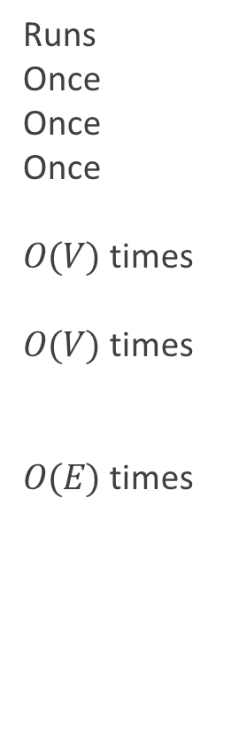
How long does it take?
Runs Once Once Once
$O(V)$ times
$O(V)$ times
$O(E)$ times
Dijkstra(G, s, e)
PQ = new priority queue
Set all node costs to infinity
s.cost = 0
for each node n in G
PQ.Insert(n, n.cost)
while PQ not empty
u = PQ.ExtractMin()
if u == end then done!
for each neighbor v of u
w = weight of edge from u to v
newCost = u.cost+v
if newCost<v.cost
PQ.DecreaseKey(v, newCost)
v.cost = newCost
v.predecessor = u

Slide 115

How long does it take?
Time per execution $$O(1) \\ O(V) \\ O(1)$$
$$O(\log{V})$$
$$O\left(\log{V}\right) \\ O(1)$$
$$O(1)$$
$$O(\log{V})$$
$$O(1)$$
Dijkstra(G, s, e)
PQ = new priority queue
Set all node costs to infinity
s.cost = 0
for each node n in G
PQ.Insert(n, n.cost)
while PQ not empty
u = PQ.ExtractMin()
if u == end then done!
for each neighbor v of u
w = weight of edge from u to v
newCost = u.cost+v
if newCost<v.cost
PQ.DecreaseKey(v, newCost)
v.cost = newCost
v.predecessor = u

Slide 116


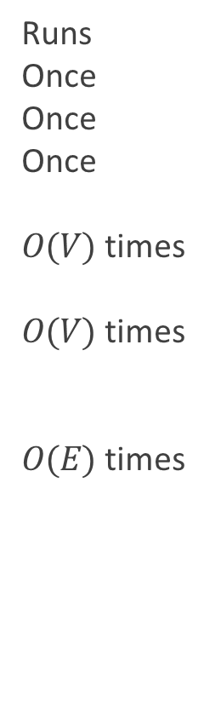
How long does it take?
Runs Once Once Once
$O(V)$ times
$O(V)$ times
$O(E)$ times
Time
$$O(1) \\ O(V) \\ O(1)$$
$$O(\log{V})$$
$$O\left(\log{V}\right) \\ O(1)$$
$$O(1)$$
$$O(\log{V})$$
$$O(1)$$
Total
$$O(1) \\ O(V) \\ O(1)$$
$$O(\operatorname{Vlog}{V})$$
$$O\left(V\log{V}\right) \\ O(V)$$
$$O(E)$$
$$O(\operatorname{Elog}{V})$$
$$O(E)$$
Dijkstra(G, s, e)
PQ = new priority queue
Set all node costs to infinity
s.cost = 0
for each node n in G
PQ.Insert(n, n.cost)
while PQ not empty
u = PQ.ExtractMin()
if u == end then done!
for each neighbor v of u
w = weight of edge from u to v
newCost = u.cost+v
if newCost<v.cost
PQ.DecreaseKey(v, newCost)
v.cost = newCost
v.predecessor = u

Slide 117
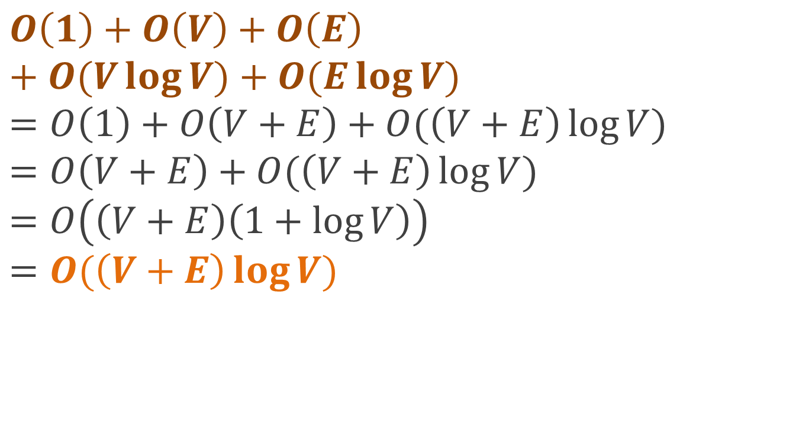
How long does it take?
$$O\left(1\right)+O\left(V\right)+O\left(E\right)+O(V\log{V)+O(E\log{V)}} \\ =O\left(1\right)+O\left(V+E\right)+O(\left(V+E\right)\log{V)} \\ =O\left(V+E\right)+O(\left(V+E\right)\log{V)} \\ =O\left(\left(V+E\right)\left(1+log{V}\right)\right) \\ =O(\left(V+E\right)\log{V})$$

Slide 118
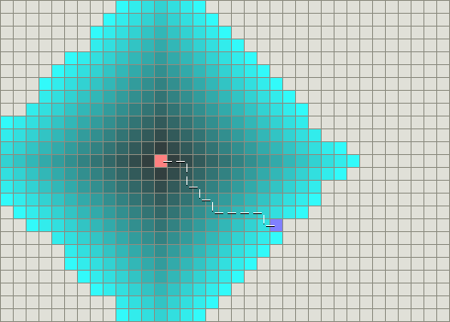
Searching for a path in a 4-connected grid
Source: http://theory.stanford.edu/~amitp/GameProgramming/AStarComparison.html

Slide 119
Dijkstra does a lot of useless searching
Dijkstra’s algorithm is a blind search algorithm
It exhaustively explores nodes in increasing order of distance
Even if they’re in the opposite direction from the goal!
Is there some way of biasing the search toward more productive nodes?
Search the more promising nodes first

Slide 120
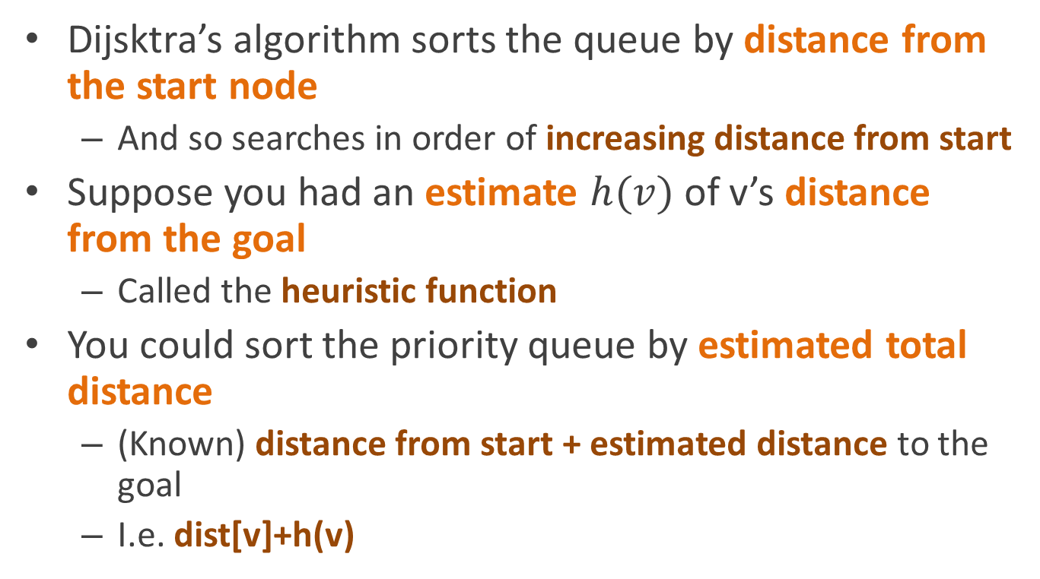
Heuristic search
Dijsktra’s algorithm sorts the queue by distance from the start node
And so searches in order of increasing distance from start
Suppose you had an estimate $h(v)$ of v’s distance from the goal
Called the heuristic function
You could sort the priority queue by estimated total distance
(Known) distance from start + estimated distance to the goal
I.e. dist[v]+h(v)

Slide 121
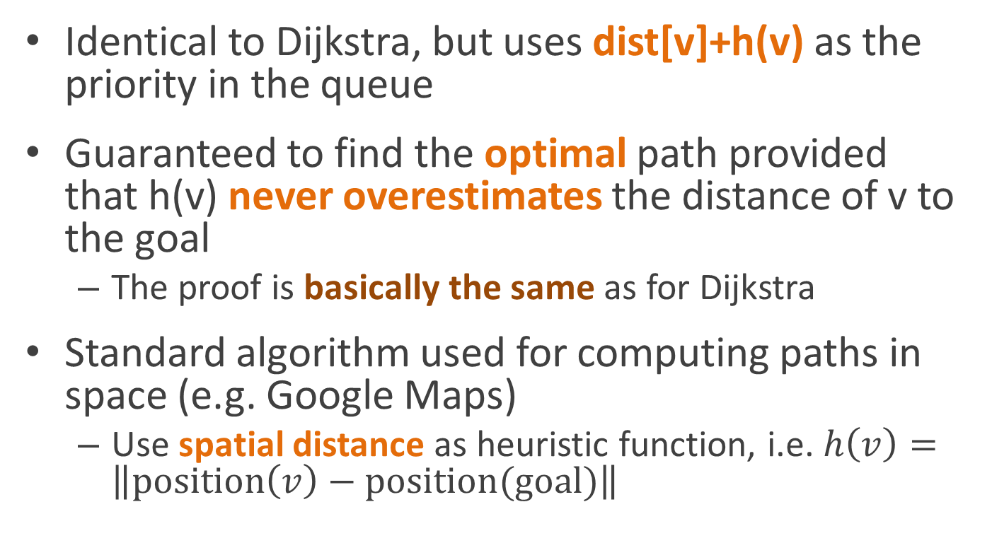
A* search
Identical to Dijkstra, but uses dist[v]+h(v) as the priority in the queue
Guaranteed to find the optimal path provided that h(v) never overestimates the distance of v to the goal
The proof is basically the same as for Dijkstra
Standard algorithm used for computing paths in space (e.g. Google Maps)
Use spatial distance as heuristic function, i.e. $h\left(v\right)=\left\|position\left(v\right)−position(goal)\right\|$

Slide 122
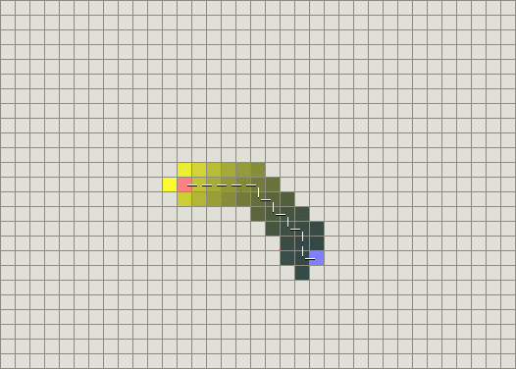
A* is way more efficient (when your problem has a heuristic function)

